Slide 1

Azure feature tradeoff analysis
https://tinyurl.com/TechBashAzureTradeoff
Jamie Romanowski

Slide 2


A few things about me
@JamieRomanowski

Slide 3
What this talk is
Review features in azure with overlapping capabilities
Learn how to use a tradeoff analysis
Discuss how to plan a Cinco De Mayo party
https://tinyurl.com/TechBashAzureTradeoff

Slide 4

What is a tradeoff analysis?
A tradeoff analysis is an approach for optimizing your decision making process for your specific needs based on comparing the impact of competing features and aligning them according to your needs.

Slide 5
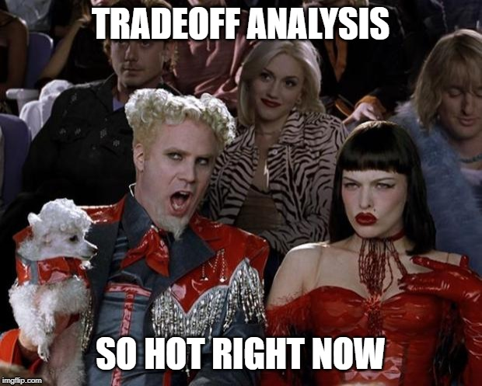

Slide 6
Tradeoff Analysis is very relevant currently
Less ecosystems are single tool focused, more freedom to diverge exists
More highly opinionated and evolving products and technologies available to choose from
Increase in distributed systems / microservices
expectation on loosely coupled services
All could be in different technologies
Team empowerment leads to less centralized decisions and more diverse technologies and tools
Easier to change and swap out technologies
With the increase in use of open source technologies, its not just buy vs build – now it’s buy, build, or leverage

Slide 7
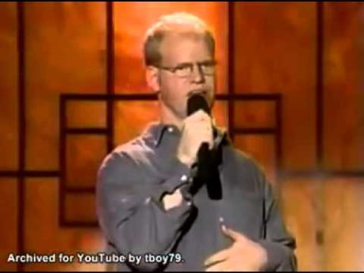
< 5 minute non-technical tradeoff analysis example

Slide 8
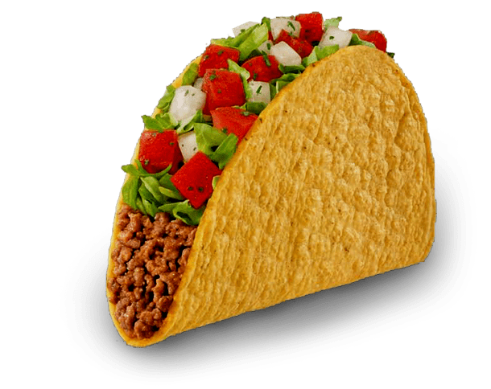
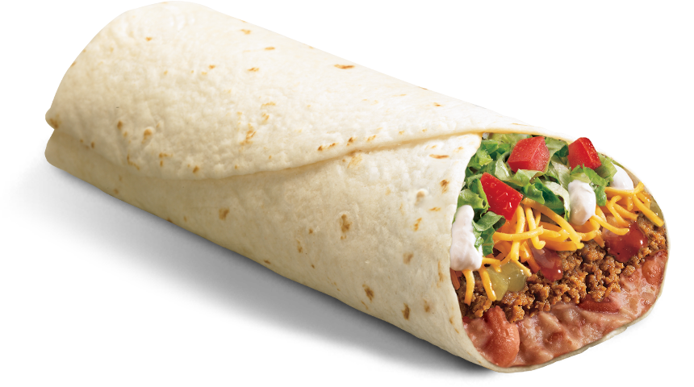
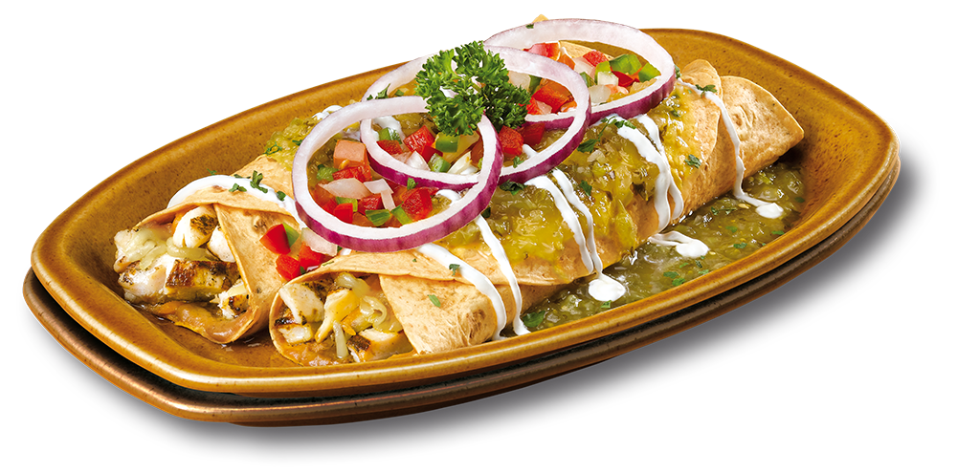
tortilla with cheese, meat, and/or vegetables…
Soft or hard
Can vary the toppings or ingredients
Could do a taco bar!
Could eat cold
Typically done with flour tortillas instead of corn
Great when you need to eat something one handed or on the go.
Typically baked and served with a sauce
Great when you want a more elegant dinner
Notes:
Tuesday night dinner
Hosting a party where people will show up at different times in the day
Dorm room with only a hot plate
A movie theater that wants to plan something for the Three Amigos remake
Tailgating before an event with no grill
A catered party at your house
Happy hour on Cinco de mayo …

Slide 9
Where deeper analysis is important
Your specific scenario
Tuesday night dinner
Hosting a party where people will show up at different times in the day
Dorm room with only a hot plate
A movie theater that wants to plan something for the Three Amigos remake
Tailgating before an event with no grill
A catered party at your house
Happy hour on Cinco de mayo …

Slide 10
Cinco De Mayo Happy Hour Tradeoff Example
You invited a few friends over for a Cinco De Mayo party at your place.
One of your friends can’t eat cheese.
One of your friends is gluten sensitive
One of your friends is allergic to onions
What is the right thing to do…

Slide 11
Cinco De Mayo Happy Hour Tradeoff Example
Assumptions
Everyone is coming from work so they should show up around the same time
All the options are equally delicious
What do I care about?
I want to show off just how good of a cook I am
Everyone can eat something
You want to have fun too and not have to spend a lot of time cooking during the party
What do I not care about?
Cost (all are about the same)
Prep time (you are taking the afternoon off – flex time!)

Slide 12


Happy hour on Cinco De Mayo Tradeoff chart
High Quality
Dion (No-cheese)
Alicia (No gluten)
Jamie (No onions)
Low maintenance during party
Decisions / Observations
I can pre-make the meats and then people can make their own tacos as they want
I can keep them warm in a crock-pot
I can keep the onions and cheese separate
I will only have to maintain the levels of ingredients if they get low

Slide 13
Happy hour on Cinco De Mayo Tradeoff chart
Show off my mad cooking skills | Probably the least sophisticated of the three | Pretty good – add guacamole and homemade salsa or maybe shrimp tacos | YES – 100x yes
No-cheese | Hard but not impossible, could do a guacamole | Could keep cheese on side | Enchilada without cheese – would impact quality
No gluten | Hard here – corn tortillas do not wrap well - impact quality | Ok here | Corn tortillas could work
No onions | Hard, but not impossible | Could make the meat without onions | Hard to make a sauce without onions - would impact quality.
Low maintenance during party | Yes – just heat and serve | Yes – crock pots and refills | Yes, just have to get them out of the oven without messing them up

Slide 14
Pro-tip
Focus on the dependencies / links that’s where the key investigation and research points are
You don’t have to do a weight if you don’t need to – it is optional
Prioritize and only include what you care about
Often times you spend more time “discussing” the weighting of decisions when if you just put down the analysis there is an obvious choice waiting for you.
If you really have to do a weight consider using a how much do you care scale/categorization – “A lot”, “Some”, “Little” – be creative, emoji, # of spicy peppers, etc.

Slide 15
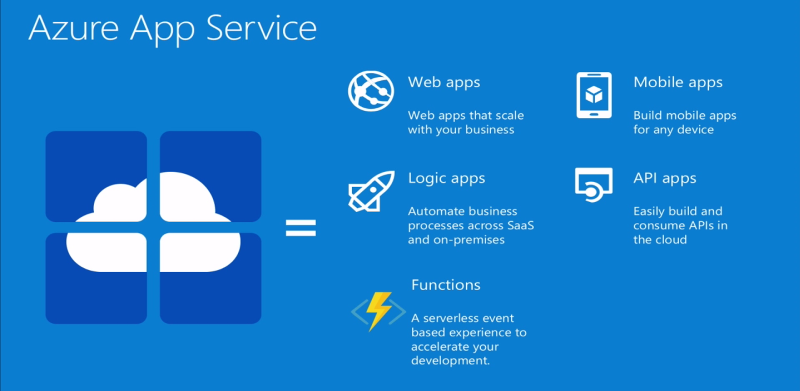
Azure Capabilities

Slide 16




Externally hosted services that allow you to run your business functions (compute) and not have to buy, maintain, or protect (to a degree) your own servers, storage, etc.
Azure app services
Azure web jobs
Azure functions

Slide 17
Azure App Service
Azure App Service is an HTTP-based service for hosting web applications, REST APIs, and mobile back ends. You can develop in your favorite language, be it .NET, .NET Core, Java, Ruby, Node.js, PHP, or Python. Applications run and scale with ease on both Windows and Linux-based environments
Hosted on managed VMs
Whole system deployed together
Pricing
billed at an hourly rate
service plans vary per size and scaling instances, VM power, memory, etc from $0.10 to $0.40 per hour

Slide 18
Azure Web jobs
Feature of app services that enables you to run a program or script in the same context as the web app.
Continuous vs Triggered
Continuous runs on all instances or a single one. can debug remotely
Always On feature - is always running (5 min gap max),
Triggered runs when triggered (timer or manual) – always runs on single instance (load balanced)
There are no limitations on time (remember they run on your web servers…)
For time triggers - execution can be at most 1 per minute
Pricing is
Cost included in your app service

Slide 19
Azure Functions
Azure functions are a premier service offering built directly on the WebJobs SDK
Trigger events – timer, storage queues and blobs, service bus, cosmos db, event hub, http, http webhooks, azure event grid
Languages – C#, F#, JavaScript, Java, Python
Can run and test locally
Integration with other services like logic apps

Slide 20
Azure Functions – hosting plans
You need a storage account to have an Azure function – this is billed separately.
Consumption Plan
Pay only for what you use
Scale automatically
Limitation – 5 minute maximum*
Azure App Service Plan
Runs like an app service on the app service plan with no time limits
Premium Plan (Preview) → GA this week
Consumption plan + enhanced performance and VNET access
Higher hourly rates
No slow starts
Unbounded run time limit --> default 30 mins
Azure Function pricing
# Executions
Execution time in GB/Seconds
Any storage you use

Slide 21

https://mikhail.io/serverless/coldstarts/azure/
Notes:
Slow starts are the amount of time needed to reload your project.
This happens if your app was not used in ~20 minutes
Mikhail Shilkov

Slide 22
Azure Functions vs Web Apps Scalability and Performance
Other than slow starts there are not many other considerations points to consider across the products.
After ~20 minutes Azure will shut down your app and it will need to be reloaded
On average 2-3 seconds to reload
Depending on size, dependencies, OS, and deployment method it can take longer
Hack - add a timer based function to Keep Alive for ~ 2,976 calls a month
In my experience, scaling problems can be unique and require unique solutions to keep them cost effective – so would need further analysis.

Slide 23
Azure Functions – Demo
DEMO – what does an Azure Function project look like…

Slide 24
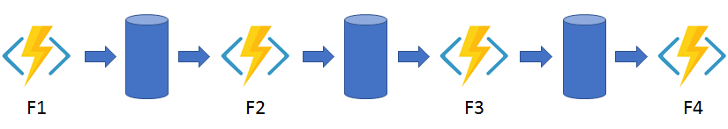
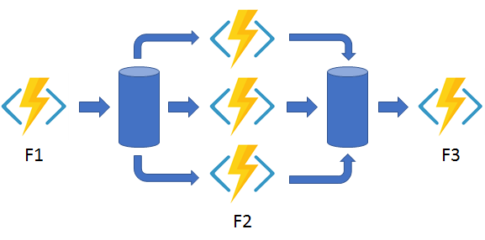
Azure Functions – Durable
Common Patterns
Function Chaining
Fan Out / Fan In (sagas)
Async HTTP calls
Polling / Timer / Monitoring
Waiting for human interaction

Slide 25
Azure Functions – hosting plans
DEMO – a more advanced durable function

Slide 26
Azure Functions – before you jump
What is really hard about functions / serverless / event based?
DEBUGGING!!!
Designing
Deconstructing

Slide 27
Azure Functions – Proxy
Function proxy
A proxy is a function that is triggered by an HTTP request and allows you to manipulate the request and/or the response.
Why would we use this
Advanced routing for scenarios like versioning (v-current, v-next, etc.)
Can help control versioning or mock out test scenarios
Please remember
This is an additional cost, as in another function that will be called in addition to the API call and it will remain active above the time of the other call

Slide 28
Azure Functions Apps Jobs - What we might care about?
Overall Cost
Billing transparency
Developer experience
Operations experience
Scalability & Performance
Architecture and Deployment strategies

Slide 29
Azure Functions vs Web Apps - pricing
Azure App Service
S1 → .10/hour 1 Core 1.75GB RAM ~$74.4 month
S2 → .2/hour
S3 → .4/hour
P1 → .2/hour
P2 → .4/hour
P3 → .8/hour
Azure Function pricing – consumption plan
# Execution * seconds (1M free)
Execution memory use in GB/s (400K free)
Any storage

Slide 30
Azure Functions vs Web Apps - pricing
Azure Function pricing
# Execution * seconds
Execution memory use in GB/s
Any storage
Assumptions:
Very simple API – 512MB
Standard Web App
Function with standard consumption plan

Slide 35
Azure Functions vs Web Apps - pricing
Pricing is complicated, but in all cases I have seen it really does match what you are using. There are not any gimmicks or short cuts that I have seen – but you must continue to analyze it and make adjustments.
Pro tip #1 – run a simulation of both of them!
Pro tip #2 – always abstract your business logic out of the root level of service, so you are not locked into the approach itself.

Slide 36
Azure Functions vs Web Apps – developer experience
They are both awesome in either Visual Studio, Visual Studio for mac, and Visual Studio Code.
Two highlights that I will mention
You can run an instance of Azure Function locally and test/debug it as it would be running in the cloud.
The Javascript / TypeScript experience of writing an azure function in VS Code is pretty sweet.
Overall – no real difference

Slide 37
Azure Functions vs Web Apps – Architecture Thoughts
Common themes in the industry when working in larger domains
DDD – isolate your system into bounded contexts which isolate areas of the system that might change together
Dev Ops – organize components into groups that need to be deployed together
Microservices - multiple teams work on independent services, enabling you to deploy more quickly — and pivot more easily when you need to
Self Organizing Teams –teams do not wait for management to direct them in order to increase agility for solving problems independently need to own related sections of a platform
These themes recommend having an architecture that is broken up into smaller deployable units (change together) that can be managed, versioned, released individually in order to increase internally efficiency and quality.
Azure functions and the whole serverless movement were built with these trends in mind.

Slide 38
Azure Functions vs Web Apps – others
Multiple Technologies
Pricing per function – pass through costs
Access to file system
Be careful to consider the implications of these if you rely on having multiple environments that need to stay in sync.

Slide 39
Pro tip - Don’t lock in when you don’t have to*
Make a choice quickly and leave your options open to change.
Do not couple your solution to the exact features of the technology. Isolate the connections to anything that you might need so that there is very little change required in order to move across technologies – unless there is a major benefit.
In the end it might make sense to try both out; or change in the future when some of your parameters or the providers approach changes.
* - there are times when it is beneficial to lock in, but with services like this that are still changing very frequently – it does not make sense to lock in prematurely

Slide 40
Use Cases
A business scenario that you might face
No brainers
For most cases you should
It really depends…so do a tradeoff analysis

Slide 41
No brainer scenarios
You have a medium volume, low to medium complex website that needs a simple back end with a lot of APIs – but the back end relies on another service that might be slow
You have an existing web site on App Service and have a small function that needs to run on a daily basis to summarize some data and cache it
You are leveraging a 3rd party API that you need to wrap some simple business logic around per call

Slide 42
Scenarios where most likely is x, but you should review
You have multiple complex front ends built with a modern js framework, this application requires a low complexity api that should get moderate usage, managed by a single team that would like to release everything together
You have a monolith application and are carving off the first service into a micro service
You have an issue in your system and you need to have something that runs every day to fix it until you get the real fix in (which could take a few days or weeks)
You have a data integration that is customer specific that you would like to execute and bill the client explicitly

Slide 43
It depends - do a tradeoff analysis
You are building an API which will vary in volume, maximum performance is key but cost is a major consideration point
You have a monolith application and are carving off the first microservice and it is a highly complex and time sensitive api
Posting a file that will kick off a data integration or internal process
Any time where good enough is not good enough

Slide 44
Why a tradeoff analysis can be more impactful than a feature comparison
It allows you to optimize for your specific scenario and not a made-up generic scenario that may not fit your situation
It shows the impact of dependencies across features [tradeoffs!]
It shows your decision making and why you made specific decisions – what you cared about
It helps you define your “why” – your reason for doing what you do – your principles
When done well it sets the path for others to understand when to and when not to use your reasoning for their specific decisions

Slide 45
My Opinionated Guiding Principles for technical decisions
Don’t make one size fits all decisions in your organization –slow down just a little and make an informed decision.
Defer decisions as long as you can and leave flexibility to change
If you don’t know – try them both out – if designed correctly, you can easily switch between these features and do a comparison on performance / cost / etc. Limit getting locked in, unless there is a key business advantage.
Only use a weighted scale when you need to – you and your teams should be able to logically discuss what is best for the business
Do not force unilateral decisions across teams – you will lead to broken systems and to teams that don’t understand the options and the reasons for decisions.

Slide 46
The beauty of deferring decisions
Wrote an application (THE BUTTON) that migrated data from a VB6 application to a modern web front end / api system
There was a very complex data mapping process that would occur between
We did not know how much this would be used and how the users would react to the time it took.
We wanted to get it out to the market as quickly as possible to learn.
#1 we built it using 2 azure functions.
1 as a http where the VB 6 program could upload a request and put it in a queue and storage
2 as a timer function that would be able to process all waiting requests.
If volume was large this would allow us to use a queue trigger and handle these concurrently
If the processing time was large we would be able to manage the amount of functions running at the same time
If we had a lot of technical issues with the dependent systems we could add in logic to retry and reprocess items
In the end, we did not need any of these because it was fast enough and the volume was spread out well – but we had options!

Slide 47
Thank you
“If anyone can refute me—show me I’m making a mistake or looking at things from the wrong perspective—I’ll gladly change. It’s the truth I’m after, and the truth never harmed anyone.” – Marcus Aurelius
If you have any feedback – good or bad, I am all ears as I would like to continue to make this presentation better.

